Slide 1
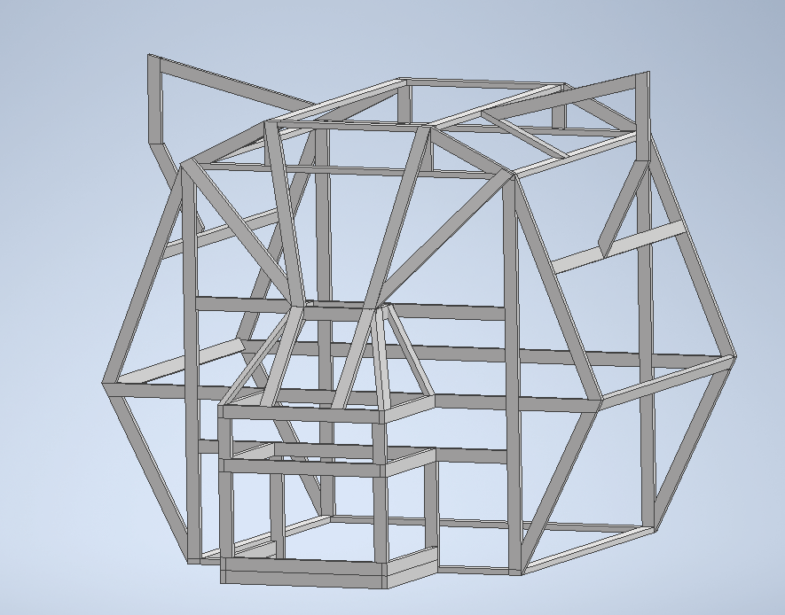
Head
25 2x4x8
16 2x4x10
1 2x4x12

Slide 2
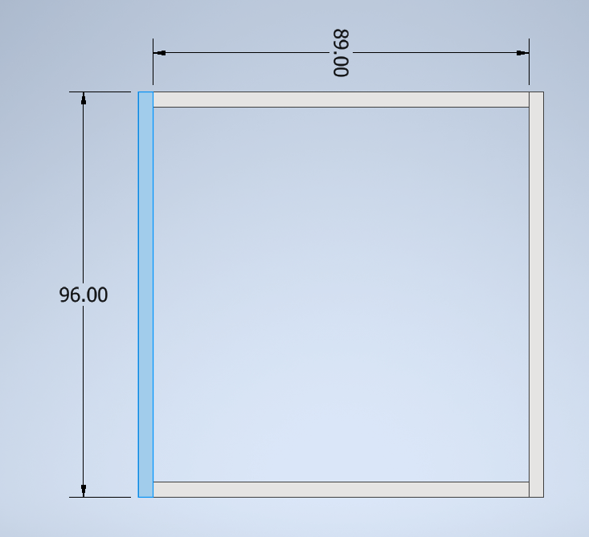
(4) 2x4x8
(2) 8’
(2) 7’5”

Slide 3
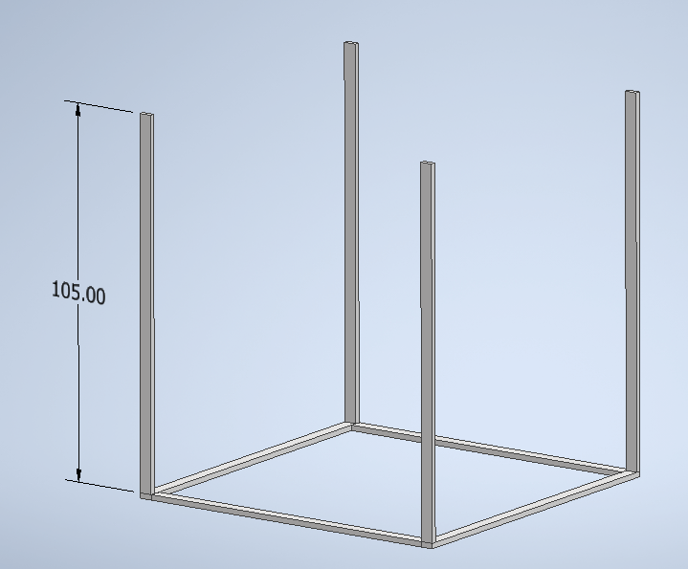
(4) 2x4x10
(4) 8’9”
  save (4) 15” leftovers

Slide 4
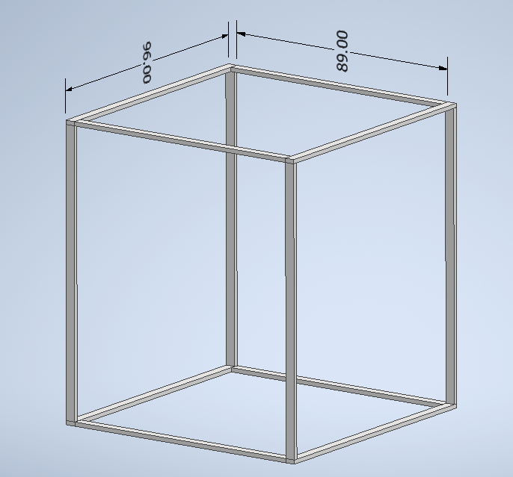
(4) 2x4x8
(2) 8’
(2) 7’5”

Slide 5
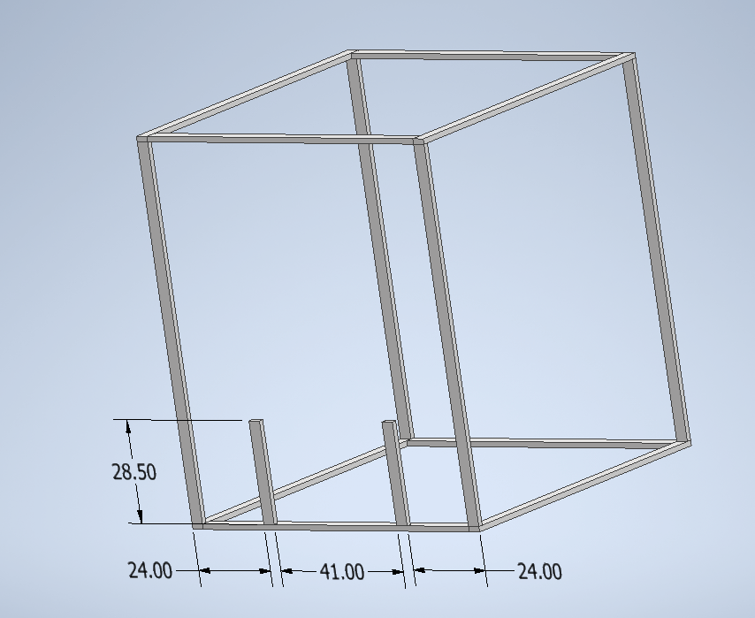
(2) 2x4x10
(2) 28.5”
  Cut ONE from EACH board
  WRITE (B) ON LEFTOVER BOARDS [91.5”] AND SAVE

Slide 6
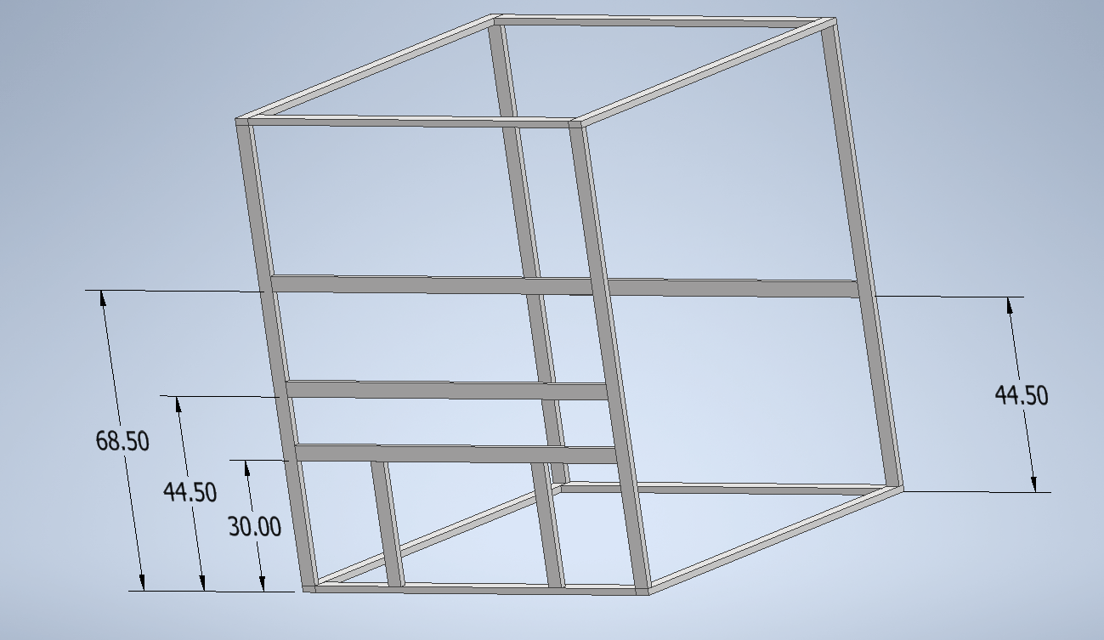
(4) 2x4x8
(4) 7’5”

Slide 7
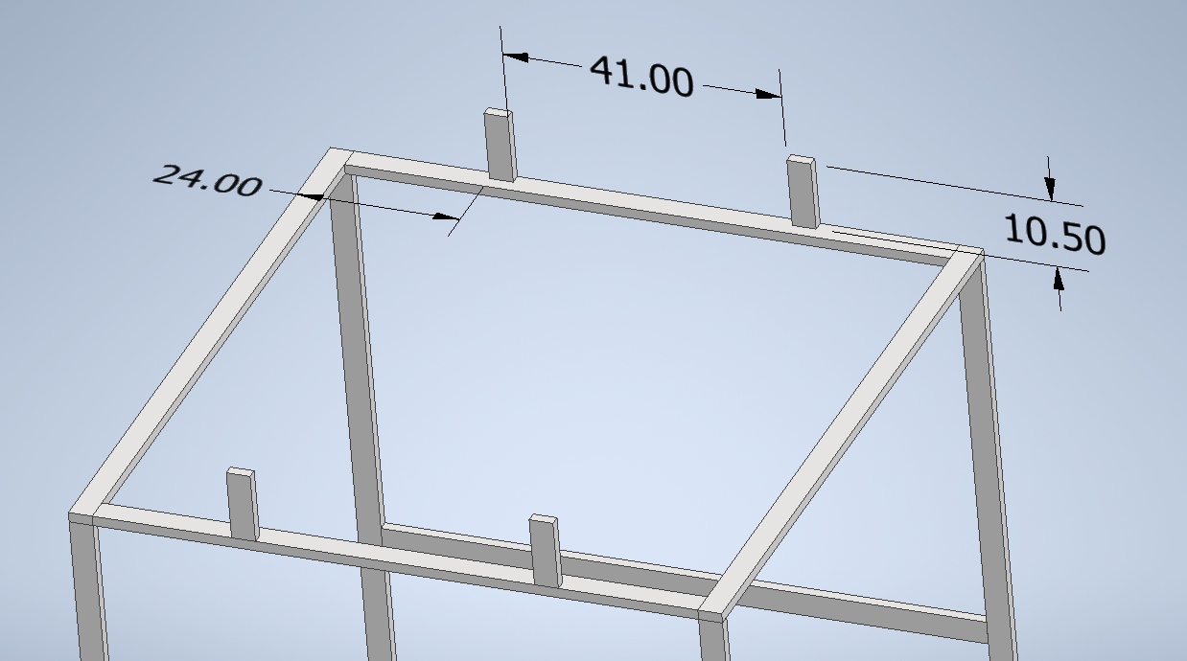
(4) 15” leftovers
(4) 10.5”

Slide 8
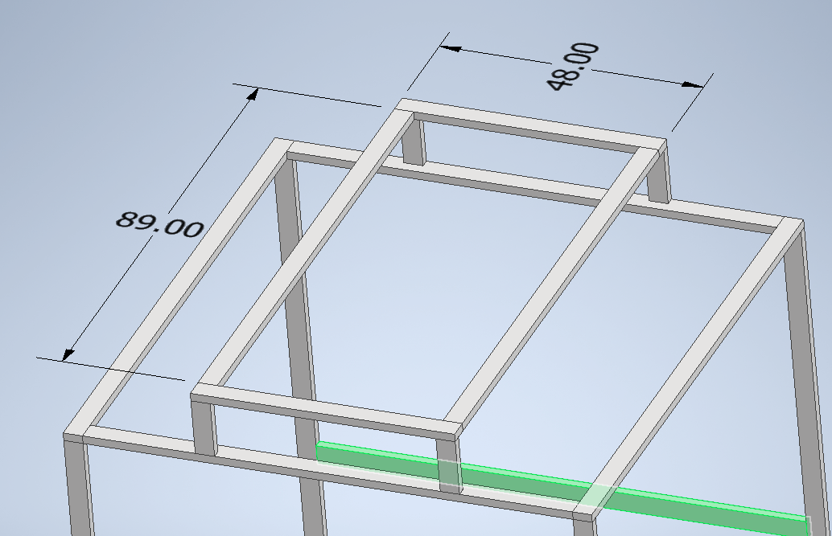
(3) 2x4x8
(2) 4’
(2) 7’5”

Slide 9
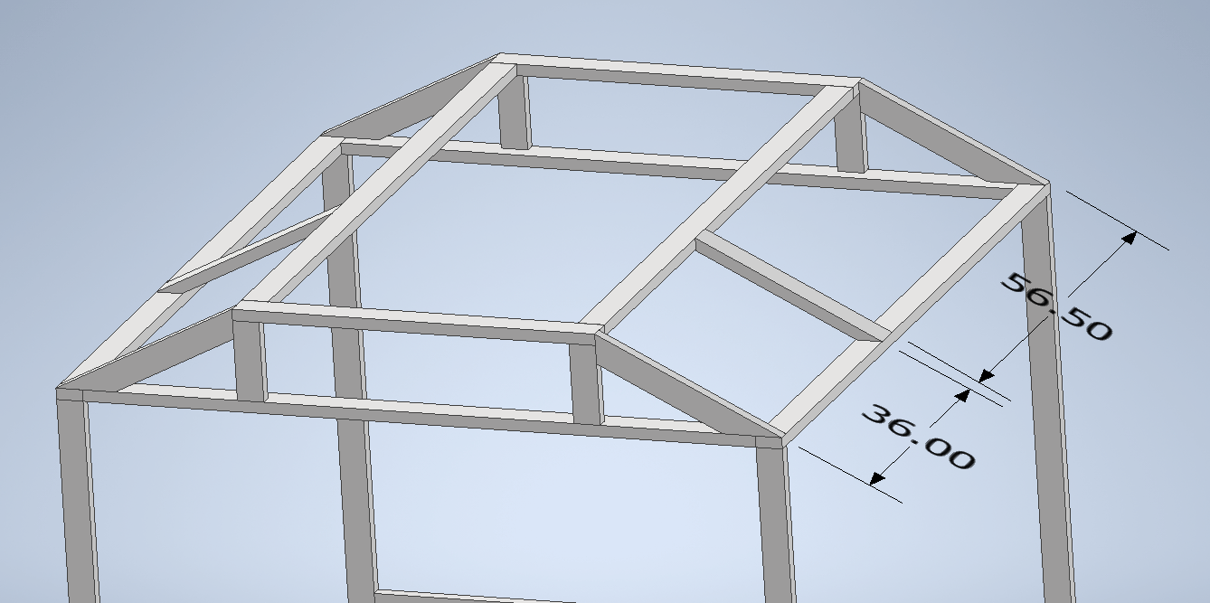
(2) 2x4x8
(6) slants
  Three slants/board
  WRITE (A) ON LEFTOVER BOARDS [15”] AND SAVE

Slide 10
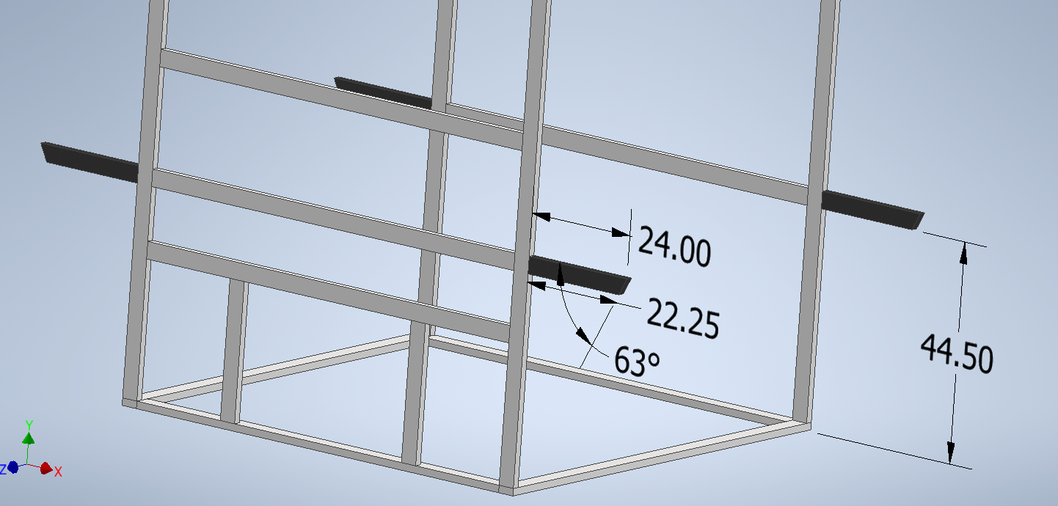
(1) 2x4x8
(4) ???

Slide 11
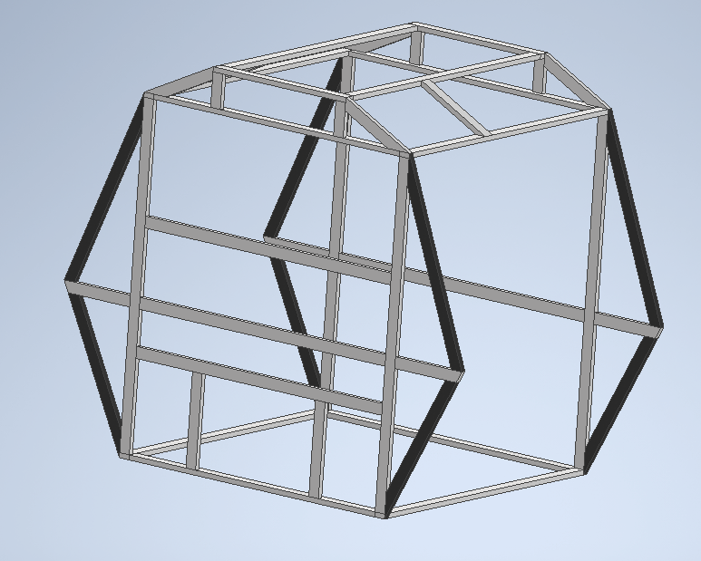
(4) 2x4x10
(8) slants
  1 long + 1 short per board

Slide 12
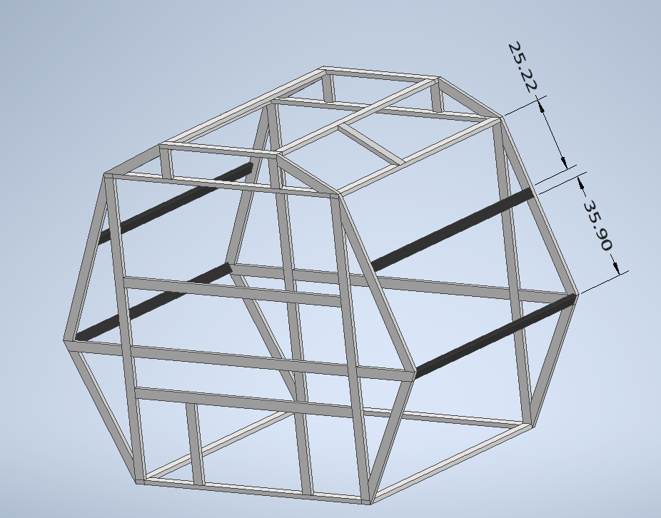
(4) 2x4x8
(4) 7’9”

Slide 13
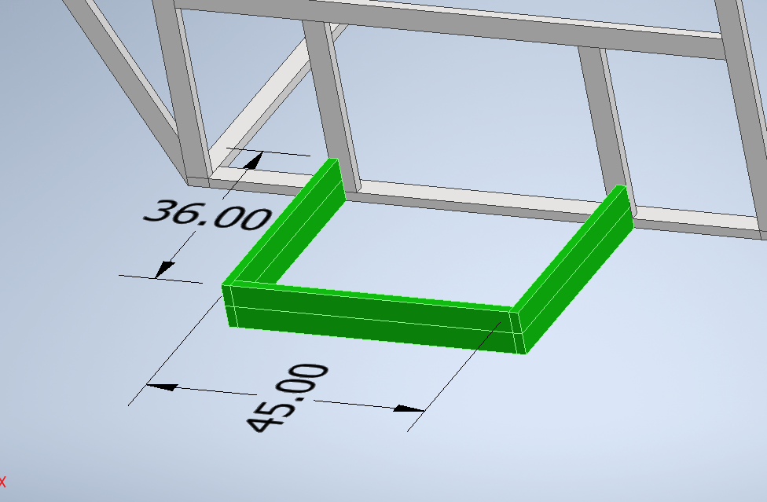
(2) 2x4x10
(4) 3’
(2) 3’9”
  (36+36+45)x2 boards

Slide 14
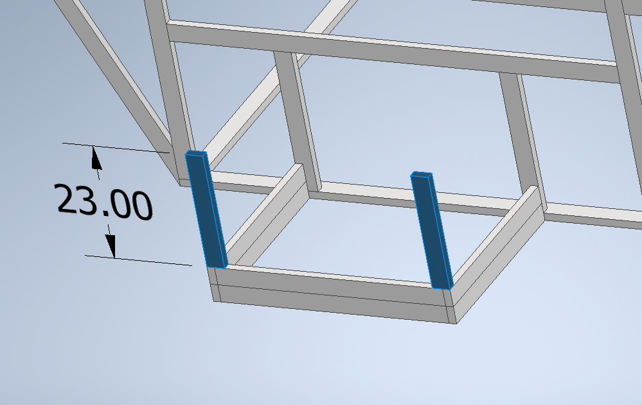
(2) B boards
(2) 23”
  Cut ONE from EACH board

Slide 15
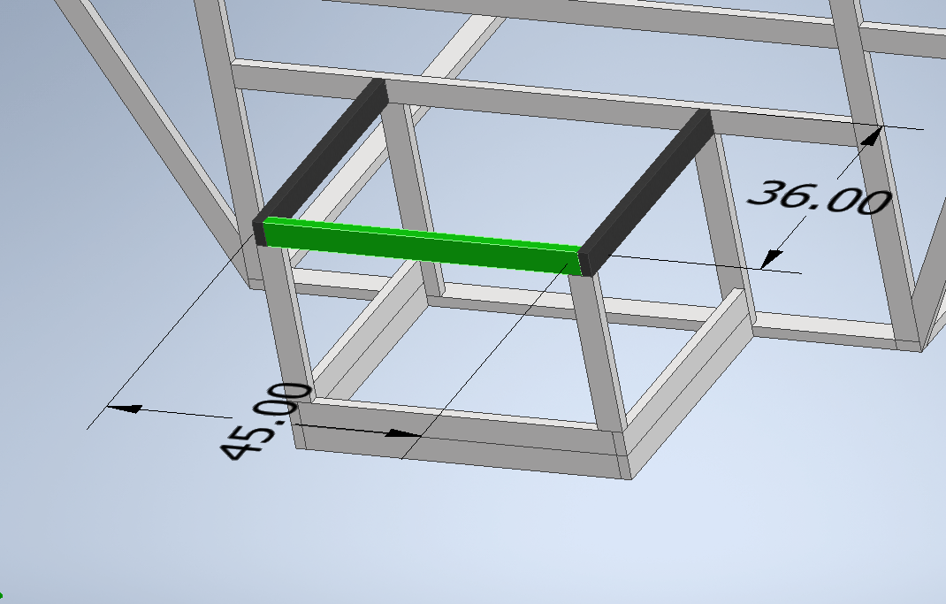
(1) 2x4x10
(2) 3’
(1) 3’9”

Slide 16
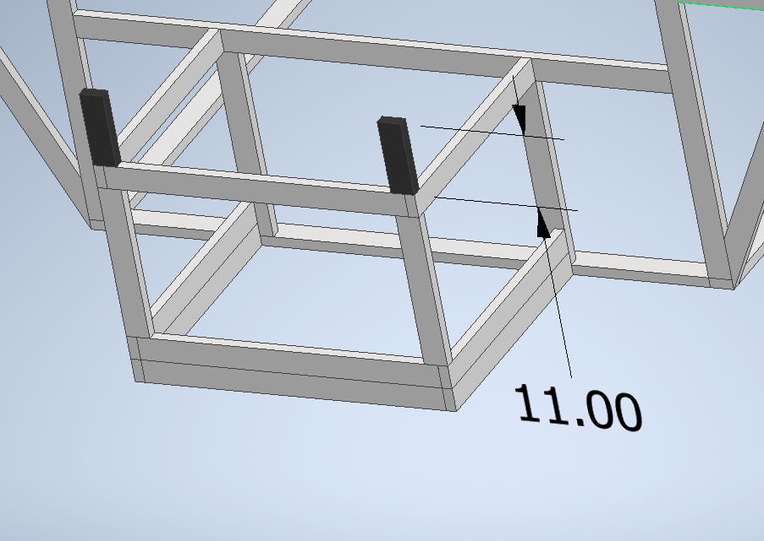
(2) A boards
(2) 11”

Slide 17
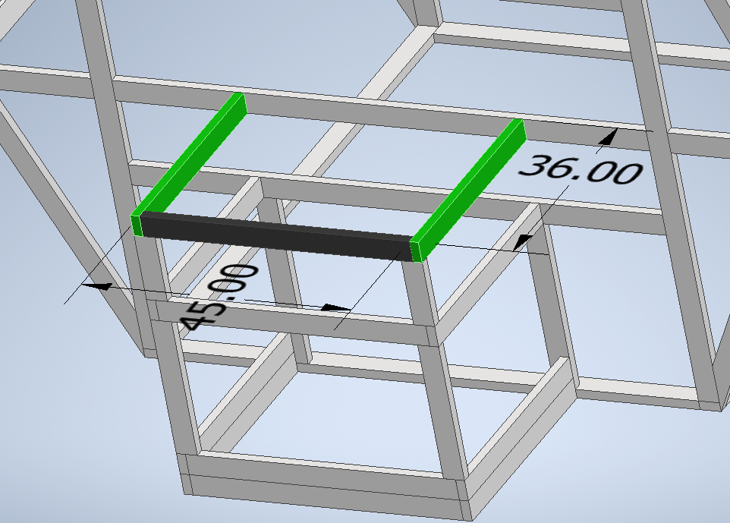
(1) 2x4x10
(2) 3’
(1) 3’9”

Slide 18
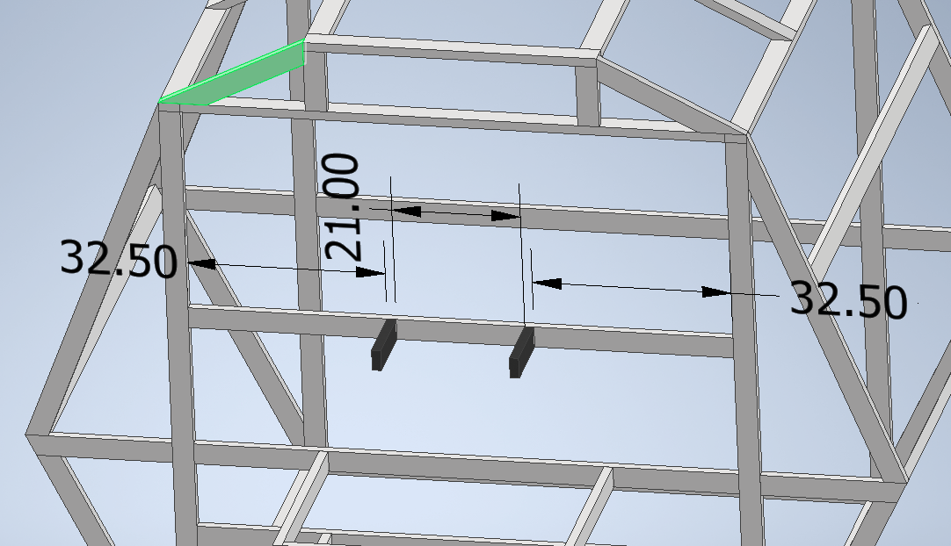
(2) 2x4x10
(2) 12”
  Cut ONE 12” from each 10’
  WRITE (E) ON LEFTOVER BOARDS [9’] AND SAVE
12.00

Slide 19
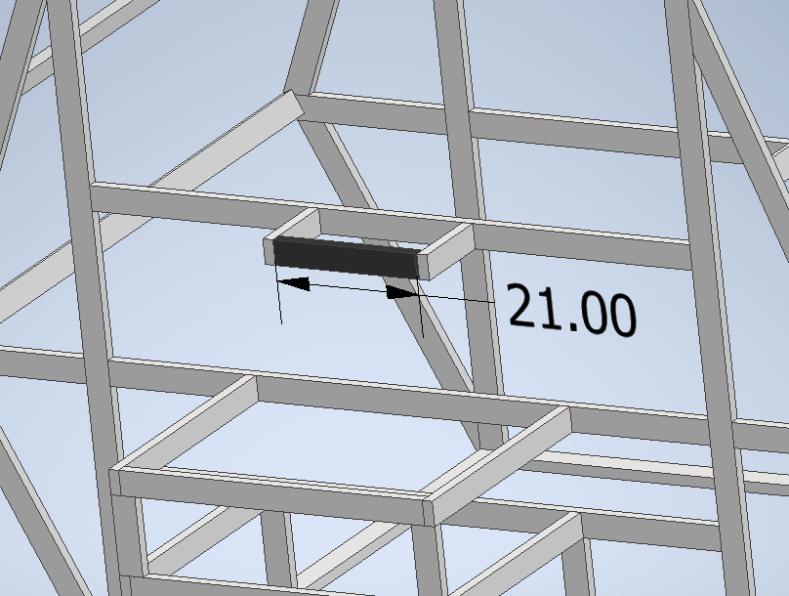
(1) scrap???
(1) 21”

Slide 20
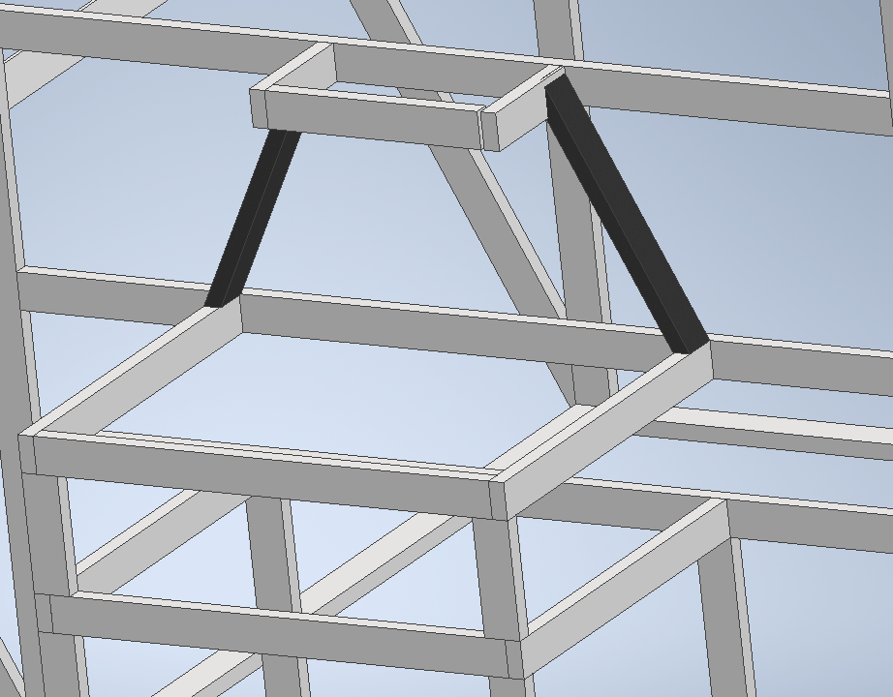
(2) D boards (75” miscuts)
(2) slants
  One from each board

Slide 21
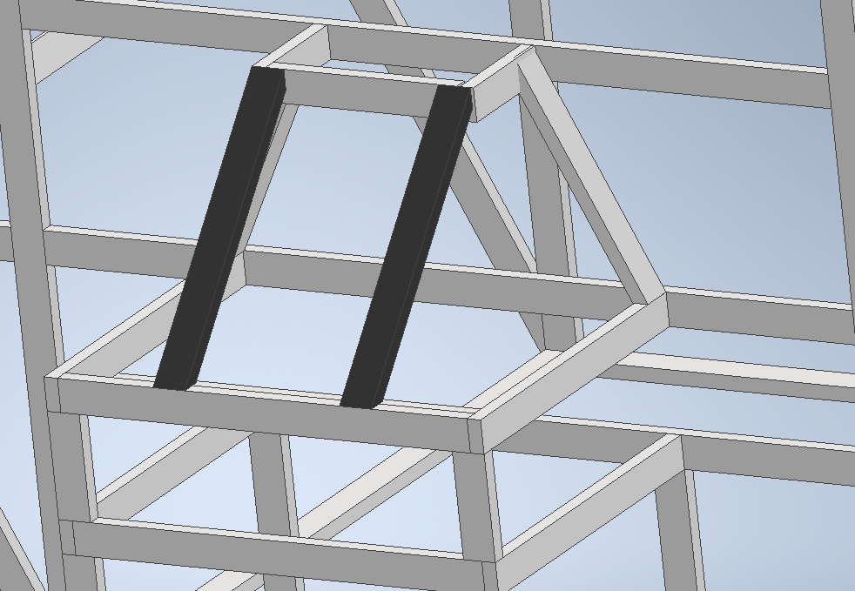
(2) B boards
(2) slants
  One from each board

Slide 22
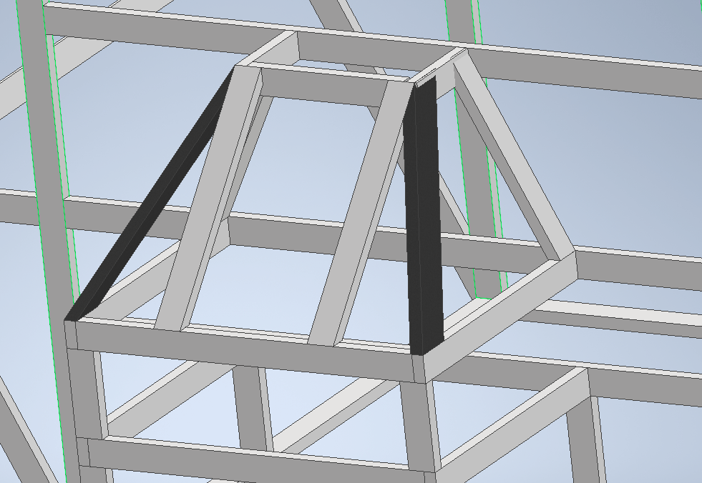
(2) D boards
(2) slants
  One from each board

Slide 23
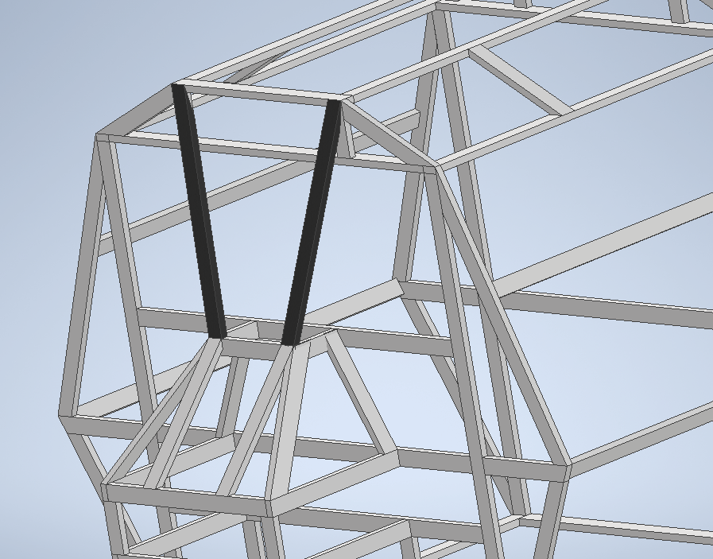
(1) E board
(2) slants

Slide 24
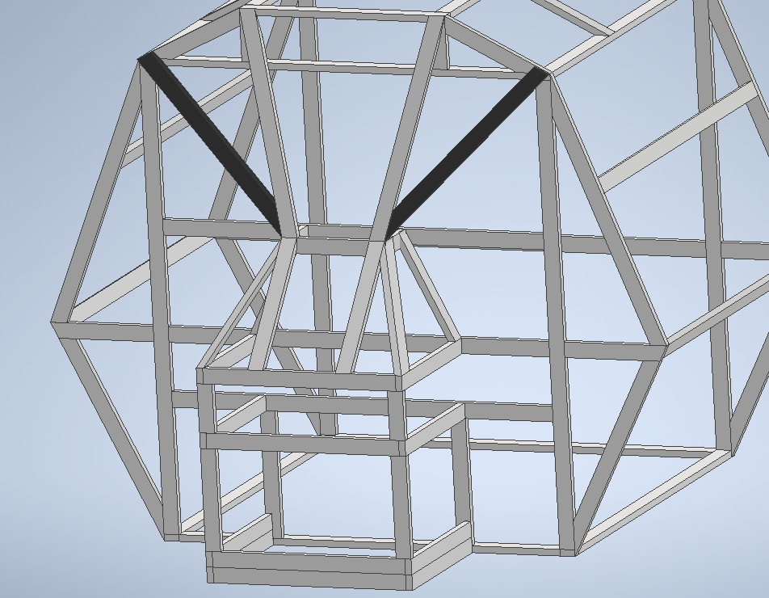
(1) E board
(2) slants

Slide 25
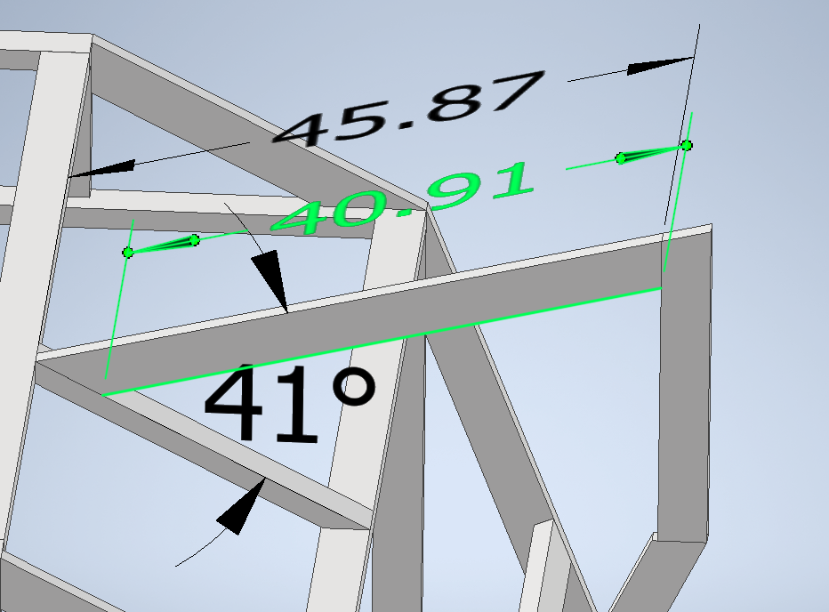
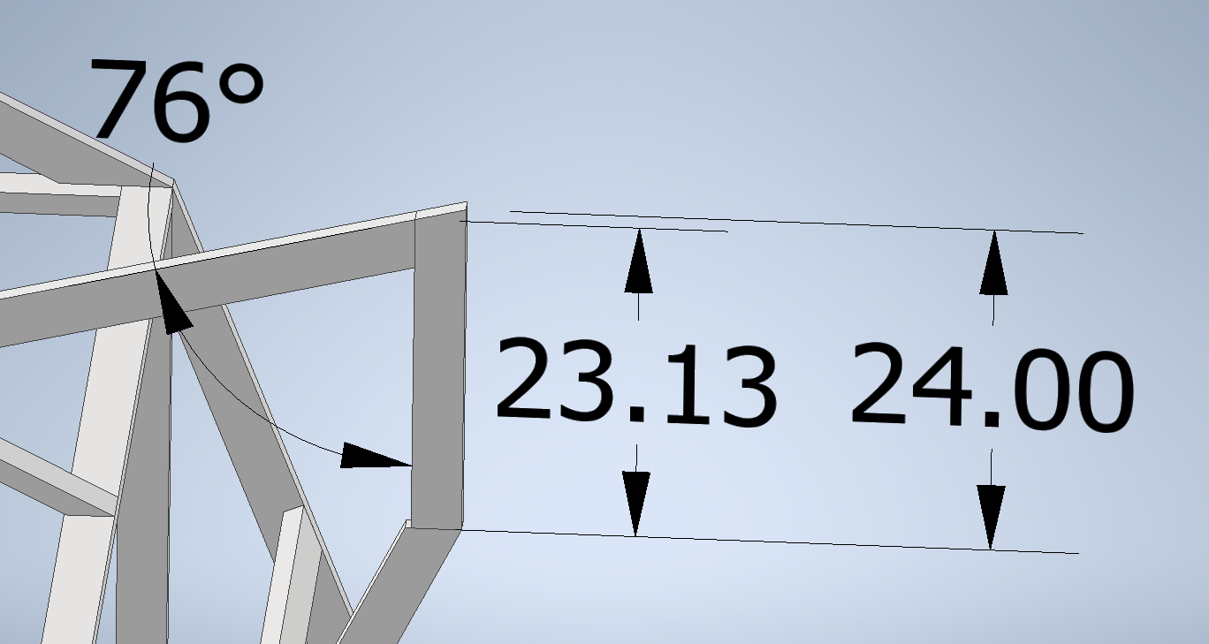
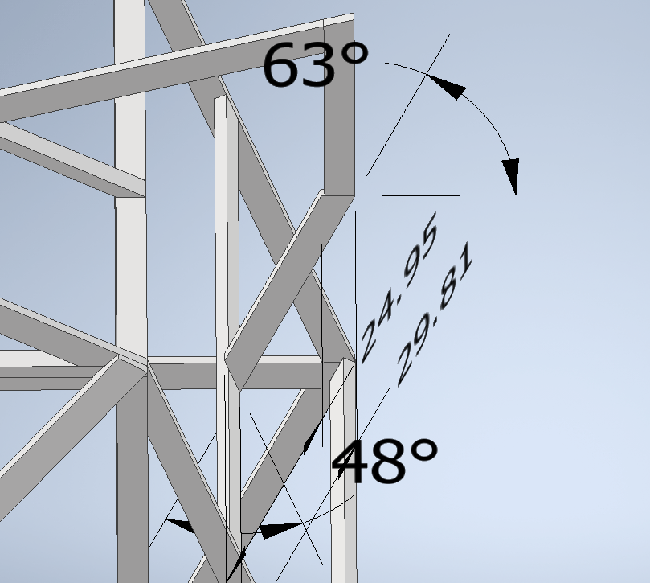
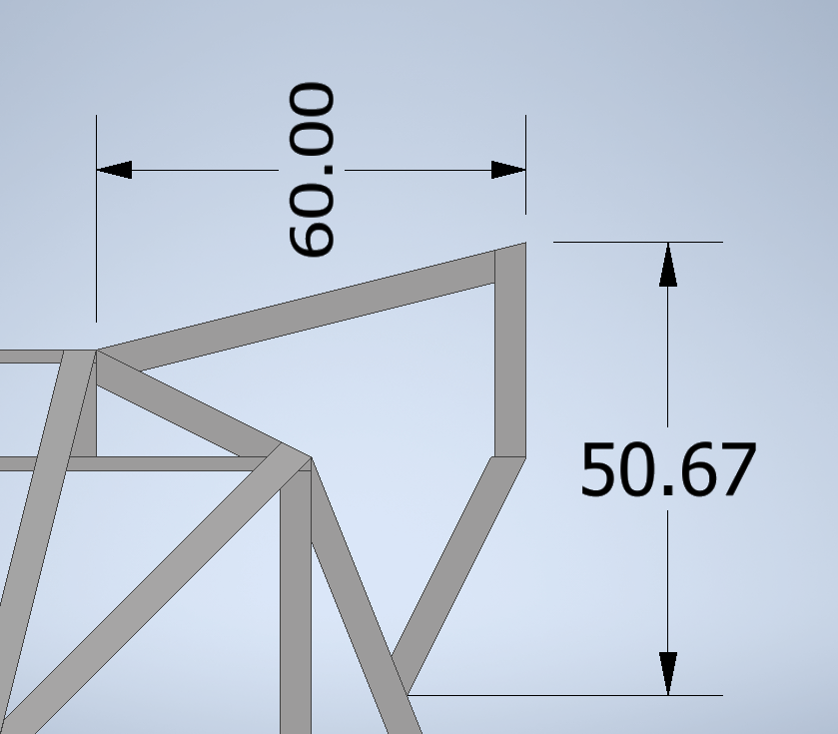
(1) 2x4x12
(2) ear tops
(2) ear sides
(2) B boards
(2) ear bottoms
  One from each board

Slide 26
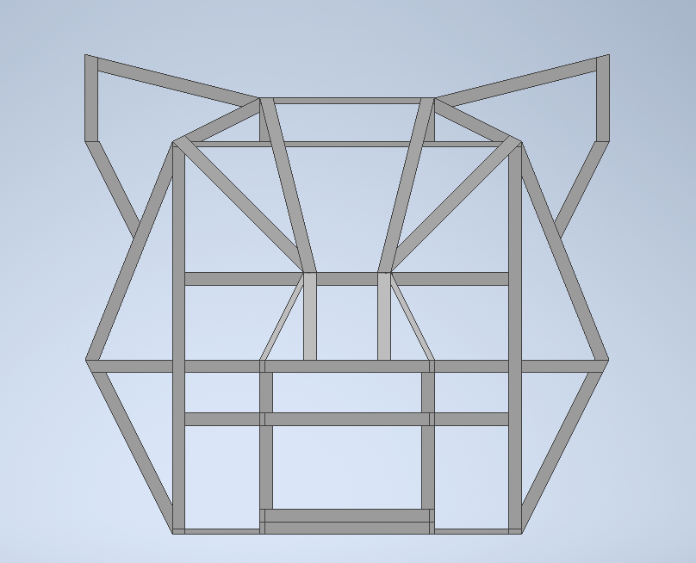
voila

